Slide 1


GAMES
ANALYSIS
Internship project by Mentorness
Presented by: Kevin Nabuule

Slide 2

OVERVIEW
01
02
03
Project Description
Dataset Description
Data Loading
04
05
06
Data Preprocessing
Questions
Project Takeaways

Slide 3


DATA DESCRIPTION
Players play a game divided into 3-levels (L0,L1 and L2)
Each level has 3 difficulty levels (Low, Medium, High)
At each level, players have to kill the opponents using guns/physical fight
Each level has multiple stages at each difficulty level.
A player can only play L1 using its system generated L1_code.
Only players who have played Level1 can possibly play Level2 using its system generated L2_code.
By default a player can play L0.
Each player can login to the game using a Dev_ID.
Players can earn extra lives at each stage in a level.

Slide 4



DATASET DESCRIPTION
The dataset is related to a game and includes two tables: `Player Details` and `Level Details`.
Player details table
P_ID: Player ID
PName: Player Name
L1_status: Level 1 Status
L2_status: Level 2 Status
L1_code: System generated Level 1 Code
L2_code: System generated Level 2 Code
Level details table
P_ID: Player ID
Dev_ID: Device ID
start_time: Start Time
stages_crossed: Stages Crossed
level: Game Level
difficulty: Difficulty Level
kill_count: Kill Count
headshots_count: Headshots Count
score: Player Score
lives_earned: Extra Lives Earned

Slide 5

DATA LOADING
DOWNLOADING DATASETS
I downloaded the datasets from the repositories and had them on my local machine in a designated folder.
After opening MySQL Workbench, create a new connection called “Game Analysis Task” using the plus(+) button .
CREATE A DATABASE CONNECTION
Under the “Game Analysis Task” connection, I created a database called “game_analysis” using the SQL command CREATE database game_analysis;
CREATE DATABASE
On tthe left pane, you find all databases, right click on the game_analysis database and then click on “Table Data Import Wizzard” and follow the procedures to import the data.
IMPORT LEVELS TABLE
On tthe left pane, you find all databases, right click on the game_analysis database and then click on “Table Data Import Wizzard” and follow the procedures to import the data.
IMPORT PLAYERS TABLE

Slide 6

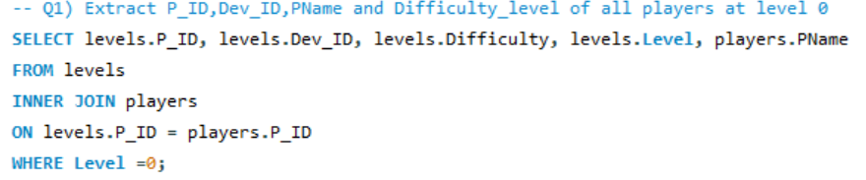
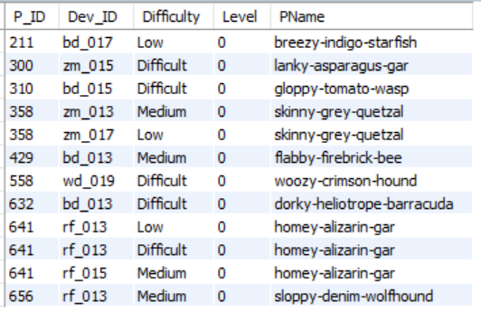
Q1) Extract P_ID,Dev_ID,PName and Difficulty_level of all players at level 0

Slide 7
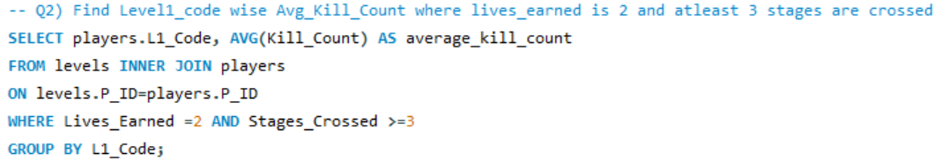
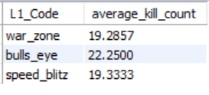
Q2) Find Level1_code wise Avg_Kill_Count where lives_earned is 2 and atleast 3 stages are crossed

Slide 8
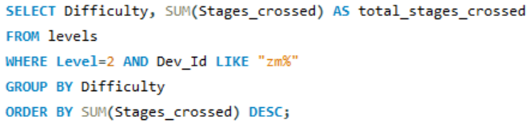
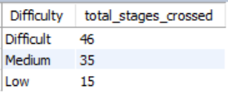
Q3) Find the total number of stages crossed at each difficulty level where for Level2 with players use zm_series devices. Arrange the results in decreasing order of total number of stages crossed.

Slide 9
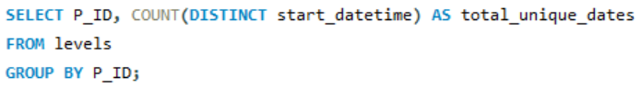
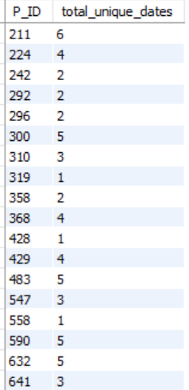
Q4) Extract P_ID and the total number of unique dates for those players who have played games on multiple days.

Slide 10
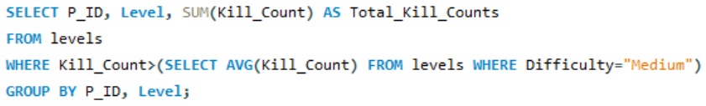
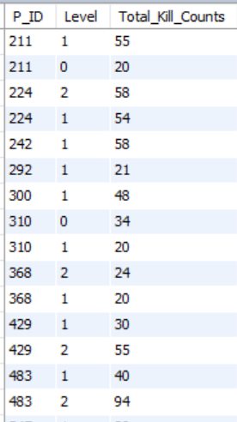
Q5) Find P_ID and level wise sum of kill_counts where kill_count is greater than avg kill count for the Medium difficulty.

Slide 11
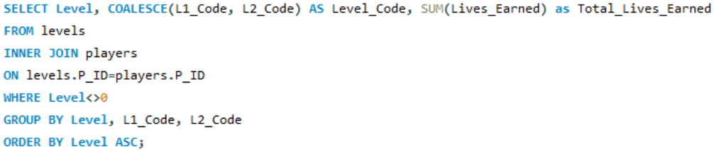
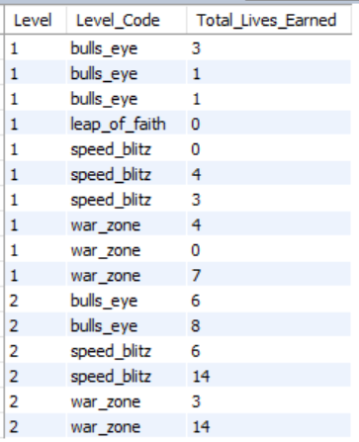
Q6) Find Level and its corresponding Level code wise sum of lives earned excluding level 0. Arrange in ascending order of level.

Slide 12
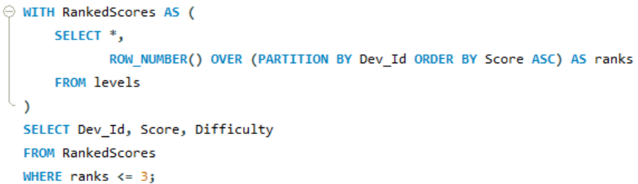
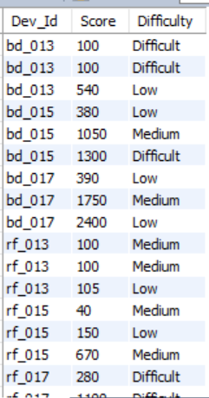
Q7) Find Top 3 score based on each dev_id and Rank them in increasing order using Row_Number. Display difficulty as well.

Slide 13
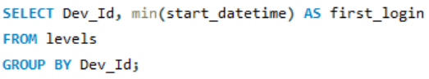
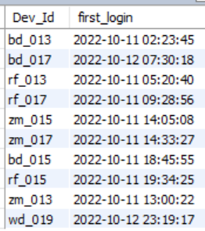
Q8) Find first_login datetime for each device id

Slide 14
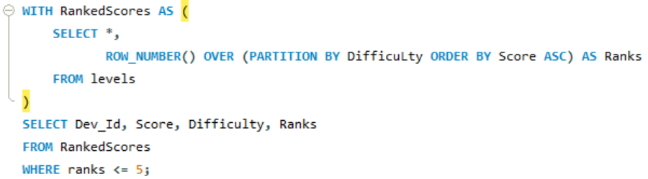
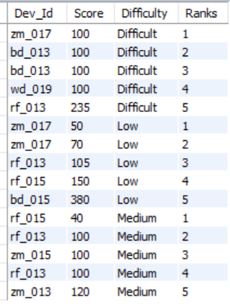
Q9) Find Top 5 score based on each difficulty level and Rank them in increasing order using Rank. Display dev_id as well.

Slide 15
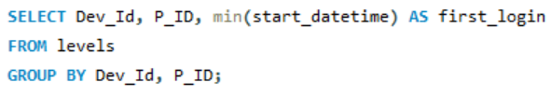
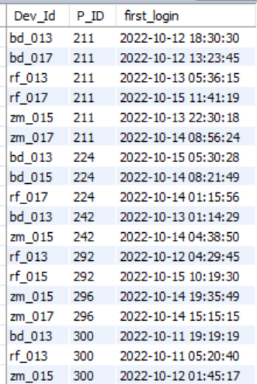
Q10) Find the device ID that is first logged in(based on start_datetime) for each player(p_id). Output should contain player id, device id and first login datetime.

Slide 16
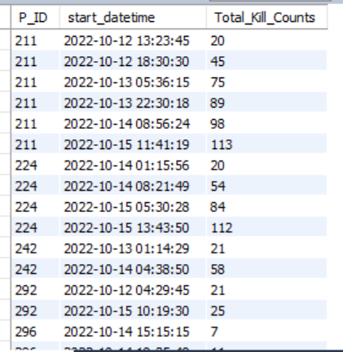
Q11) For each player and date, how many kill_count played so far by the player. That is, the total number of games played by the player until that date.
a) window function
b) without window function

Slide 17
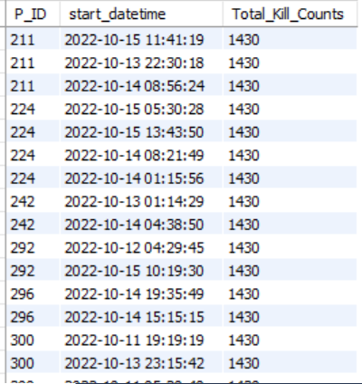
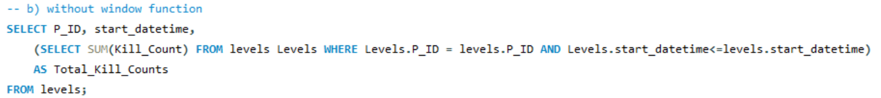
Q11) For each player and date, how many kill_count played so far by the player. That is, the total number of games played by the player until that date.
a) window function
b) without window function

Slide 18
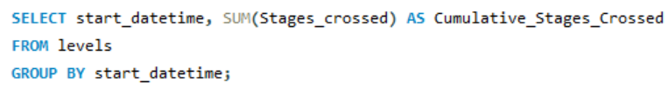
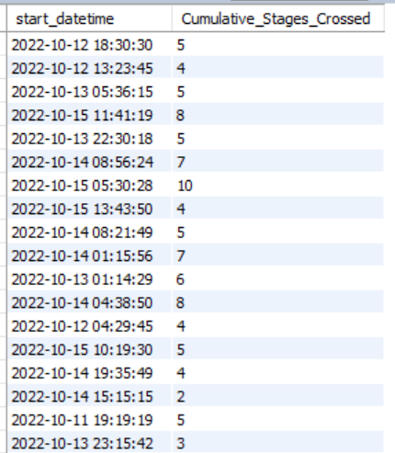
Q12) Find the cumulative sum of stages crossed over a start_datetime

Slide 19
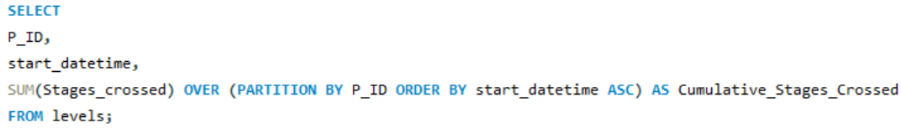
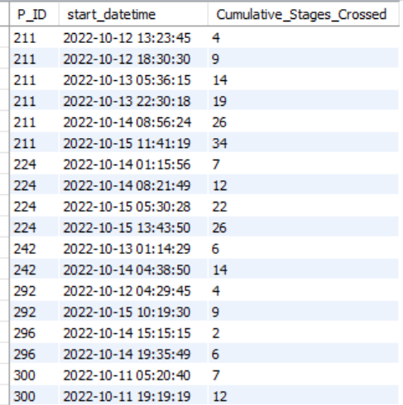
Q13) Find the cumulative sum of an stages crossed over a start_datetime for each player id but exclude the most recent start_datetime

Slide 20
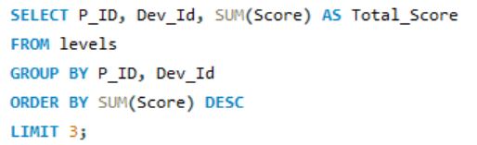
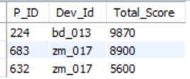
Q14) Extract top 3 highest sum of score for each device id and the corresponding player_id

Slide 21
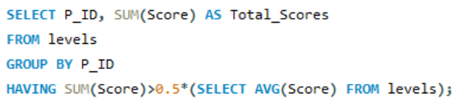
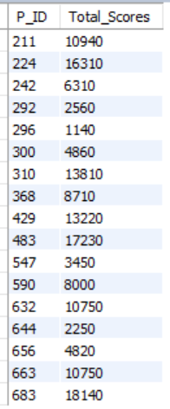
Find players who scored more than 50% of the avg score scored by sum of scores for each player_id

Slide 22
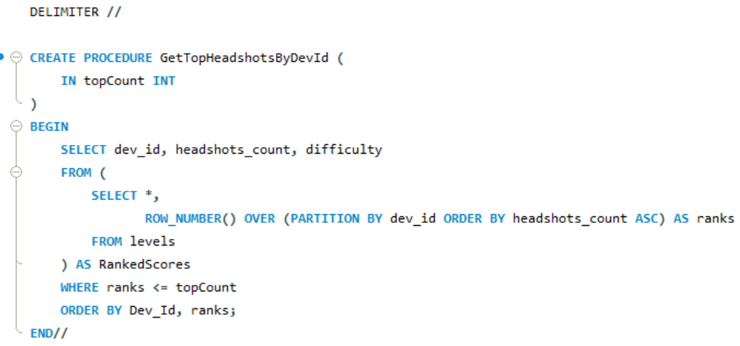
Q16) Create a stored procedure to find top n headshots_count based on each dev_id and Rank them in increasing order using Row_Number. Display difficulty as well.

Slide 23
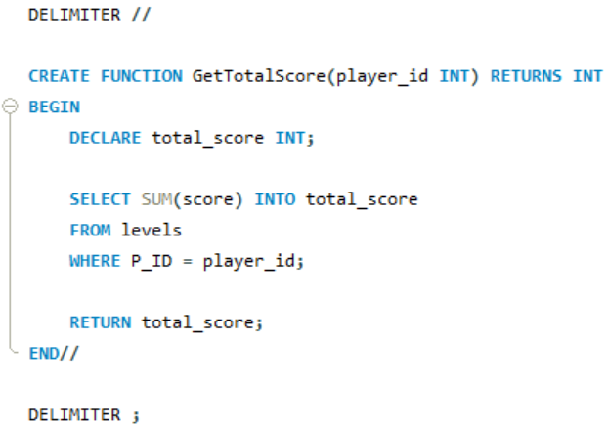
Q17) Create a function to return sum of Score for a given player_id.

Slide 24






PROJECT TAKEWAYS
SQL joins
SQL joins help us connect different tables in the same database most especially when data needed in separate table. The join maybe inner, outer, left, right, natural, or full join.
Querying data
This is the part that enables us to select specific information from the tables. This is guided by use of SELECT, WHERE, and FROM clauses for any foundational querying.
Aggregation and grouping
This concept deals with use of AVG, MIN, MAX, SUM and COUNT functions to get some information. Grouping enables us to specify the criteria on which to extract our data.

Slide 25

Thank's For Watching

